Slide 1
04-4 Graphical Front End via node.js
How to add a pretty face via a web browser

Slide 2
Ways to Add Graphics
ncurses (http://www.gnu.org/software/ncurses/)
X Window System (http://www.x.org/wiki/)
Qt (http://qt.digia.com/) both X-based and embedded
Web server
node.js (http://nodejs.org/)

Slide 3
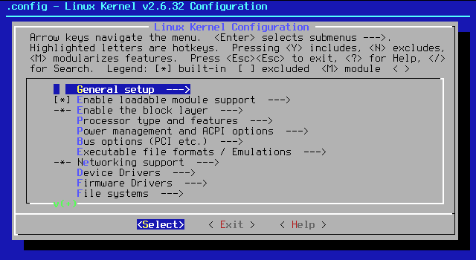
ncurses
http://en.wikipedia.org/wiki/File:Linux-menuconfig.png

Slide 4
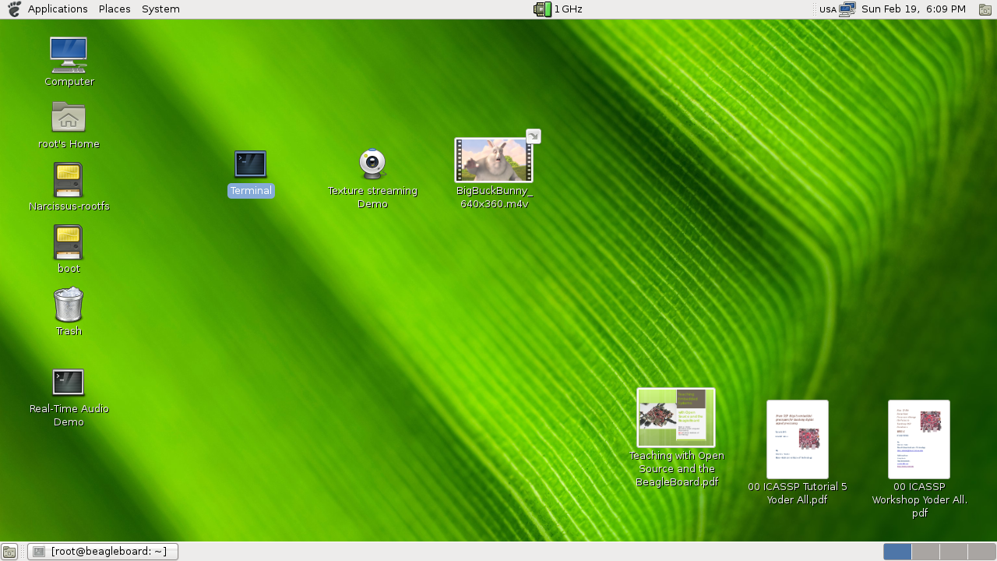
X Windows

Slide 5
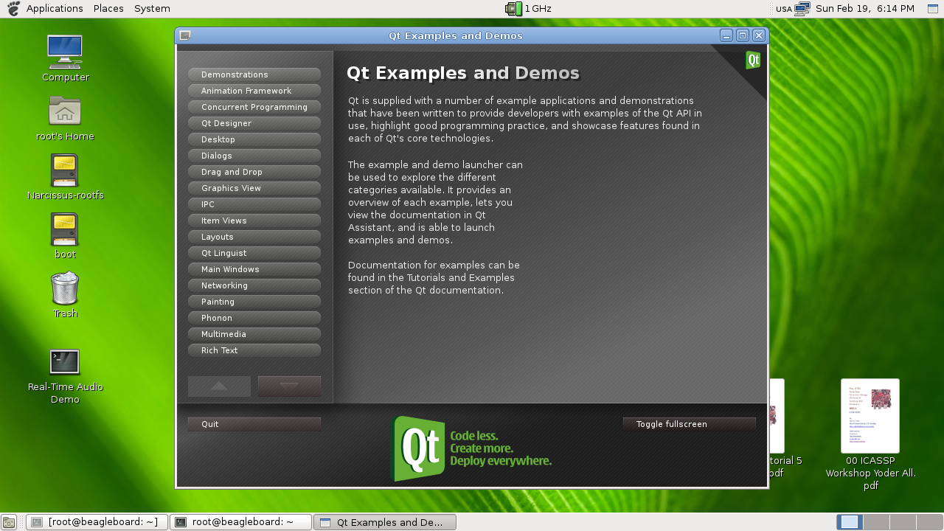
Qt – Both X and embedded
$ opkg install qt4-demos
$ qtdemo
http://elinux.org/ECE497_Notes_on_Qt

Slide 6
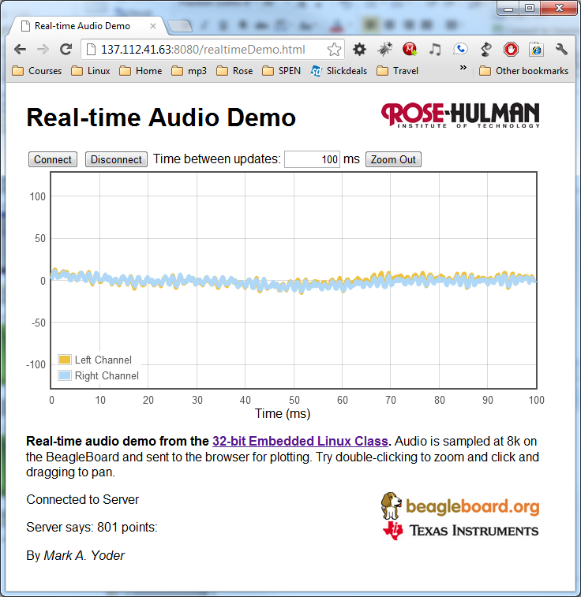
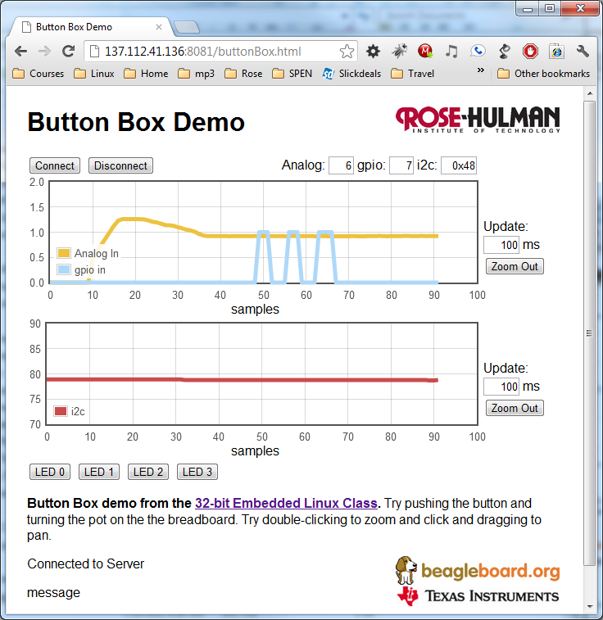
Via the Web via node.js
beagle$ cd ~/exercises/node.js/realtime
beagle$ node realtime.js
beagle$ cd ~/exercises/node.js/realtime
beagle$ node buttonBox.js

Slide 7
node.js
Platform built on Chrome's JavaScript runtime for easily building fast, scalable network applications.
Uses an event-driven, non-blocking I/O model that makes it lightweight and efficient, perfect for data-intensive real-time applications that run across distributed devices.
Programmed in JavaScript on both server and client.
http://nodejs.org/

Slide 8
node.js example: Webserver
This simple web server written in Node responds with "Hello World" for every request.
var http = require('http');
http.createServer(function (req, res) {
res.writeHead(200, {'Content-Type': 'text/plain'});
res.end('Hello World\n');
}).listen(1337);
console.log('Server running on port 1337');
To run the server, put the code into a file example.js and execute it with the node program:
$ node example.js
Server running on port 1337

Slide 9
Things to know
JavaScript
socket.io
jQuery
DOM
html
CSS
Where to you start?

Slide 10
Javascript – C-like
#include <stdio.h>
main() {
int i;
for(i=0; i<5; i++) {
printf("i=%d\n", i);
}
}
var i;
for(var i=0; i<5; i++) {
console.log("i=%d", i);
}

Slide 11
JavaScript in 10 minutes
By Spencer Tipping
https://github.com/spencertipping/js-in-ten-minutes
27 pages
Here are the highlights…

Slide 12
JS - Types
Strings – e.g. 'foo', "foo" (single vs. double quotation – no difference)
Numbers – e.g. 5, 3e+10 (all numbers behave as floats)
Booleans – true and false.
Arrays – e.g. [1, 2, "foo", [3, 4]].
Objects – e.g. {foo: 'bar', bif: [1, 2]}, which are really just hashtables.
Functions – e.g. var example=function (x) {return x + 1}.

Slide 13
JS - Functions
Functions are first-class lexical closures
var f = function () { // f is toplevel, so global
var x = 5; // x is local to f
y = 6; // y is global
};
Watch out
var f = function () { // f is toplevel, so global
y = 6; // y is global
x = 42;
Do stuff…
var x = 5; // x is local to f
};

Slide 14
JS - Semicolon
Javascript doesn’t require a semicolon at the end of each line, but you should anyway.
var x = f
(y = x) (5)
Is treated as:
var x = f(y = x) (5)
You probably meant
var x = f;
(y = x) (5);

Slide 15
JS - Equality
Never use == or !=
Always use === or !==
All these are true:
null == undefined
null == 0
false == ''
'' == 0
true == 1
true == '1'

Slide 16

JavaScript: The Good Parts
It is intended for programmers who, by happenstance or curiosity, are venturing into JavaScript for the first time.
It is also intended for programmers who have been working with JavaScript at a novice level and are now ready for a more sophisticated relationship with the language.
Most programming languages contain good parts and bad parts. I discovered that I could be a better programmer by using only the good parts and avoiding the bad parts.
JavaScript is a language with more than its share of bad parts.
172 pages

Slide 17
Things to know
JavaScript
socket.io
jQuery
DOM
html
CSS

Slide 18
socket.io
http://socket.io/
Socket.IO aims to make realtime apps possible in every browser and mobile device, blurring the differences between the different transport mechanisms. It's care-free realtime 100% in JavaScript.

Slide 19
socket.io
Server
var io = require('socket.io').listen(80);
io.sockets.on('connection', function (socket) {
socket.emit('news', { hello: 'world' });
socket.on('my other event', function (data) {
console.log(data);
});
});
Client - Browser
<script>
var socket = io.connect('http://localhost');
socket.on('news', function (data) {
console.log(data);
socket.emit('my other event', { my: 'data' });
});
</script>

Slide 20
socket.io
See: Getting Started With node.js and socket.io (v0.7+) – Part 2
http://codehenge.net/blog/2011/12/getting-started-with-node-js-and-socket-io-v0-7-part-2/
My code is based on this

Slide 21
Things to know
JavaScript
socket.io
DOM
jQuery
html
CSS

Slide 22
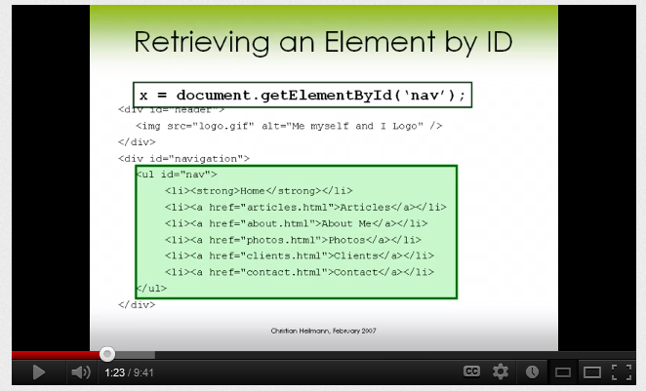
DOM
Essentials of the DOM and JavaScript in 10 Minutes
http://www.youtube.com/watch?v=URF2sVQWuxU
10 minute YouTube video
However we’ll use jQuery, it’s much more compact

Slide 23
Things to know
JavaScript
socket.io
DOM
jQuery
html
CSS

Slide 24
jQuery
http://jquery.org/
jQuery is a fast and concise JavaScript Library that simplifies HTML document traversing, event handling, animating, and Ajax interactions for rapid web development. jQuery is designed to change the way that you write JavaScript
Looks like $() in html
Analog: <input id="ainNum" type="text" value="" style="text-align: right; width:2em">
In JavaScript
$("#ainNum").val(ainNum).change(function () {
ainNum = $(this).val();
});

Slide 25
Things to know
JavaScript
socket.io
DOM
jQuery
html
CSS
FLOT
http://www.flotcharts.org/
Flot is a pure JavaScript plotting library for jQuery, with a focus on simple usage, attractive looks and interactive features.

Slide 26
To Do
Look at ~/exercises/node.js/realtime and see what you can figure out.

